Slide 1

RAG Builder: Unlocking Your Private AI Knowledge
In the rapidly evolving landscape of AI and Generative AI, businesses face an urgent need for intelligent, secure, and accurate knowledge retrieval. RAG Builder is designed to meet this demand, offering a cutting-edge solution for private AI and document-RAG.

Slide 2


Industry & Market Context: The Demand for Intelligent Knowledge
AI-Powered Document Retrieval
Private Chatbot Solutions
Businesses require secure, personalized AI assistants trained on their proprietary data.
Growing demand for smarter ways to access and utilize internal documents.
Knowledge Automation
A timely solution for businesses aiming to streamline information access and efficiency.

Slide 3

Target Users & Market Reach: Empowering Innovators
Who We Serve
Startups seeking agile AI solutions.
SMEs optimizing their knowledge management.
Developers building custom AI experiences.
Teams needing AI chatbots trained on their own documents.
Addressing Key Pain Points
Eliminating slow information retrieval.
Consolidating fragmented knowledge bases.
Enabling deep AI customization.

Slide 4
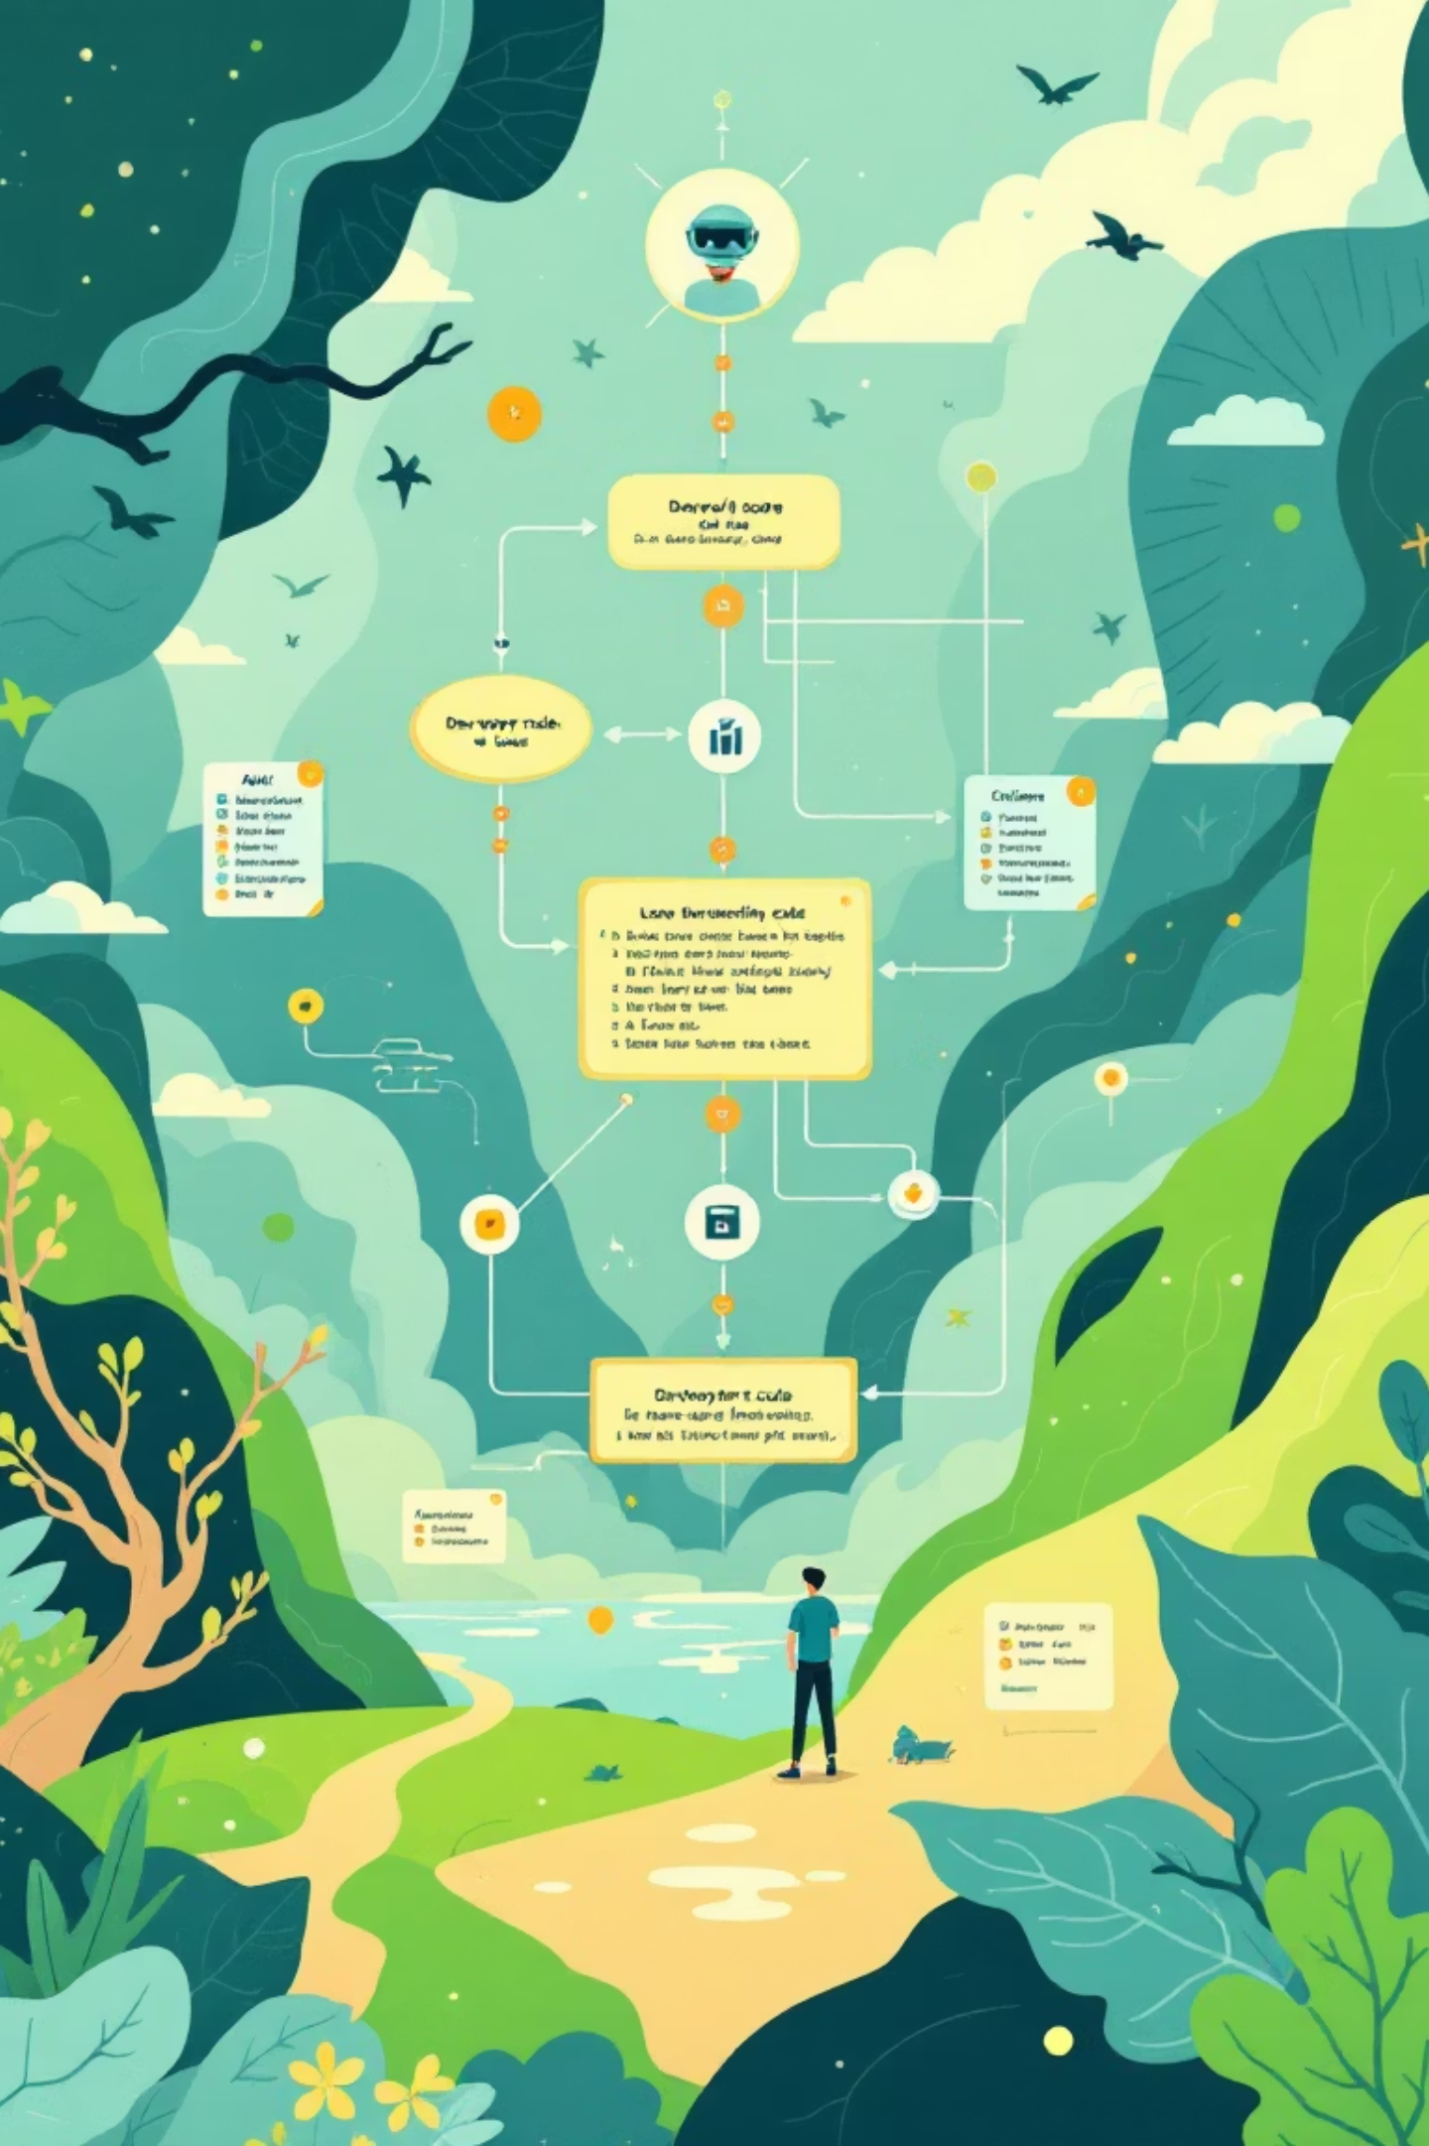
Competitive Edge: Why RAG Builder Stands Out
Full-Stack Control
Easy Embedding Management
Unparalleled command over your AI pipeline, from data ingestion to deployment.
Simplify the complex process of vector embeddings for accurate retrieval.
Seamless Developer Workflow
Designed for ease of integration and use, empowering developers to build faster.

Slide 5
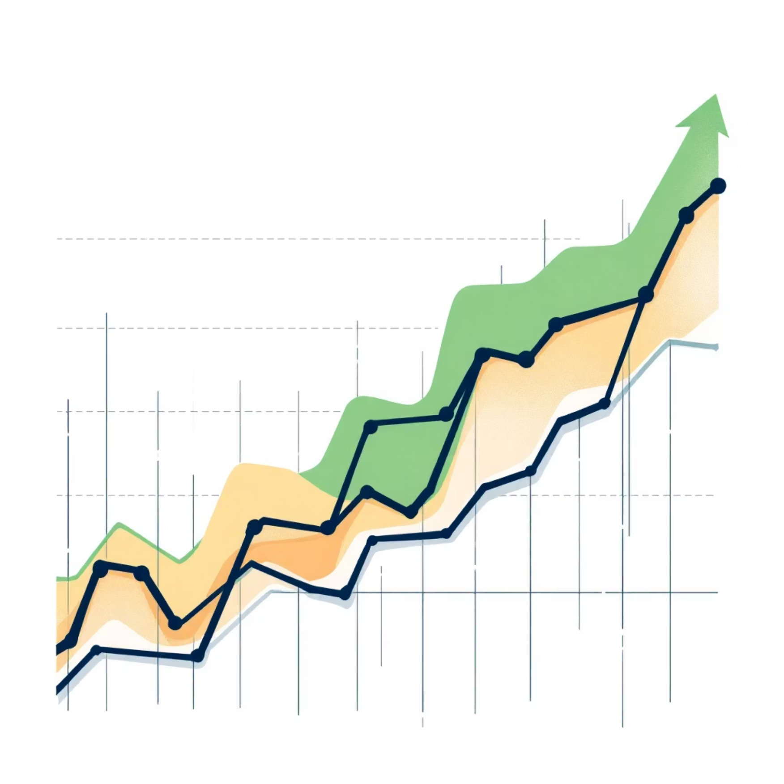



Pricing & Adoption Strategy: Flexible Growth
Flexible Pricing Models
Subscription-based for predictable costs.
Usage-based for scalable solutions.
Tailored for both individual developers and large enterprises.
Developer Communities
GitHub & AI Forums
Direct Outreach
Engaging with and supporting the builder ecosystem.
Leveraging key platforms for visibility and adoption.
Targeting businesses in need of private AI solutions.

Slide 6

Opportunities & Challenges: Navigating the AI Landscape
Opportunities
Challenges
Rapid AI Adoption
Intense Competition
Capitalizing on the global shift towards AI-first strategies.
Differentiating in a crowded market with unique value propositions.
Enterprise Knowledge Automation
Regulatory Compliance
Navigating evolving data privacy and AI ethics regulations.
Meeting the demand for efficient internal information systems.
Infrastructure Scalability
SaaS Integration
Ensuring the platform can handle increasing user demand and data volume.
Expanding through strategic partnerships and seamless integrations.

Slide 7
Projected Impact & Roadmap: Future Forward
Enhanced Workflows
Increased Accuracy
Streamline operations and boost overall team productivity.
Reduced Search Time
Improve the reliability and precision of retrieved knowledge.
Dramatically cut down the time spent looking for information.
Future Roadmap
Analytics Dashboards
Multi-Tenant Support
Gain deeper insights into knowledge usage and performance.
Expand capabilities for diverse organizational structures.
Multilingual Capabilities
Enhanced Security Protocols
Break down language barriers for global teams.
Continuous improvement in data protection and compliance.

Slide 8



RAG Builder: Your Partner in Intelligent Automation
RAG Builder offers a robust, flexible, and developer-friendly solution for private AI and document-RAG. Join us in transforming how businesses access and leverage their most valuable asset: knowledge.

